Slide 1
CMPE 220
System Software
– or –
History of Computing
Notes:
Let’s talk about history.
California State Railroad Museum – 1976 - docents worked on original steam engines.

Slide 2
System Software / History of Computing
Programming
Architecture
Machine language
Loaders
Assembly language
Macro Processors
Linkers
Compilers
Schedulers
Memory Managers
Servers
Microprogramming
CISC
RISC
Distributed Systems
Networked Systems

Slide 3
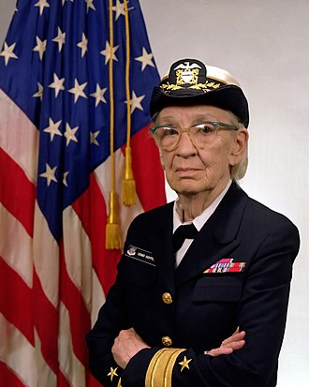
Rear Admiral Grace Murray Hopper
December 9, 1906 – January 1, 1992
PhD, Mathematics, Yale University, 1934
One of the first programmers of the Harvard Mark I computer, she was a pioneer in computer programming who invented one of the first linkers.
She popularized the idea of machine-independent programming languages, which led to the development of COBOL, an early high-level programming language still in use today.
Notes:
Met in 1974 – so we are really that close to the pioneers in computing.

Slide 4

My Background
Robert Nicholson
BS, Computer Science - 1975 CSU, Chico
MS, Computer Engineering – 1978 Stanford University
Engineering and Management: Hewlett-Packard, Oracle, Silicon Graphics, Sun Microsystems, Red Herring Communications, NASA, various startups
While in college, started a company building kit computers for local businesses

Slide 5
Housekeeping
Class information in Canvas
Email: robert.nicholson@sjsu.edu
Grading
Assignments: 30%
Midterm: 25%
Final: 45%
Course grades will be based on a curve. Per CMPE Department policy, the median total score will earn a B+. Approximately one third of the class will earn higher grades, and another one third will earn lower grades.
Textbook (recommended):
System Software: An Introduction To Systems Programming, 3rd Edition Leland L. Beck – 1996

Slide 6
Exams and Proctoring
The Midterm and Final Exams will be in Canvas, administered during scheduled exam times.
Exams are open book, open notes, open Internet

Slide 7
Examples and Assignments
Examples will be based on Unix/Linux/POSIX – and if you don’t know what that means, I’m about to explain.
Programming assignments will be short and can be done on any system, but I strongly advise that you use a Unix/Linux/POSIX system, for several reasons:
It’s going to be easier for you
I probably can’t help with questions or problems you encounter on other systems
It’s effectively an industry standard. From a career standpoint, you should be proficient in it!
So, let’s see why it’s so important…

Slide 8
How Software Became Portable
Before the 1970s, every computer manufacturer distributed bundled software with their systems – compilers, databases, editors, and so on. Once you chose a computer vendor, you were “locked in” to their systems.
There was virtually no independent software industry.
Three things changed that:
The development of system-independent programming languages
The development of system independent databases (SQL)
The proliferation of Unix/POSIX based systems

Slide 9
How “Unix” Became a De Facto Standard
Unix was developed in the 1970s at Bell Labs by Ken Thompson, Dennis Ritchie, and others, but licensing was very restrictive
An operating system – the Berkeley Standard Distribution (BSD) – based on Unix was developed at Berkeley and released in 1977. Mac OS is based on BSD.
Another system based on Unix – Linux – was developed by Finnish software engineer Linus Torvalds in the early 1990s. Many Linux variants were created by other developers.
The IEEE Computer Society released a family of standards – the Portable Operating System Interface (POSIX) – in 1997.
Over 70% of all web servers, and approximately 98% of the top 1 million web servers, run POSIX compliant operating systems.

Slide 10
Machine Code – Common in 1940s
Instruction | Action
0101 1111 1111 0001 | Load the value from the following address into the A register; advance the program counter by 2
0011 1110 1000 0101 | (data address)
0111 1111 1111 0001 | Subtract the following value from the A register; advance the program counter by 2
0000 0000 0000 1100 | (value = 12)
0110 1111 1111 0001 | Store the value from the A register into the following address; advance the program counter by 2
0011 1110 1000 0101 | (data address)
0110 1010 1111 0001 | Compare the following value to the A register; if A is less than or equal to the value, jump to address
0000 0000 0001 0100 | (value = 20)
0100 1000 1000 0110 | (program address)
Notes:
Problems: (1) Really hard and error prone – (2) no idea what this code does! - (3) – tied to machine architecture - (4) Need to remember what each address is used for – (5) Not relocatable – if you want to load things at a different place in memory, addresses change

Slide 11
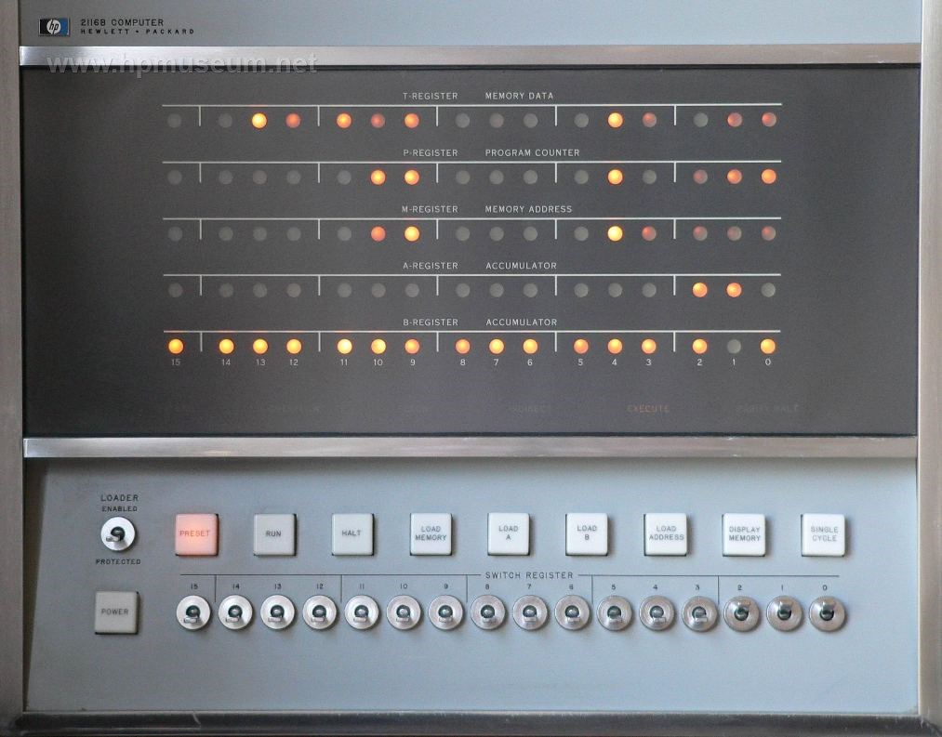
HP 2116 – circa 1966

Slide 12
Problems with Machine Code Programming
Really hard and error prone
Really hard to “read” code
Tied to machine architecture
Need to remember what each address is used for
Not relocatable – if you want to load things at a different place in memory, addresses change

Slide 13
Assembly Language
Instruction | Action
LDA inventory | Load the value from the specified location into the A register
SBA 12 | Subtract a value (12) from the A register
STA inventory | Store the value from the A register into the specified location
CMPA 20, low_inventory | Compare the A register to a value (20); if A <= 20, go to the address “low_inventory”
• • •
low_inventory:
Notes:
Improvements:
Easier to remember and code, less error prone – (2) Locations identified by name – (3) Identifiers can be mapped to different memory addresses (this is one of the things a loader does Problems: Still tied to machine architecture

Slide 14
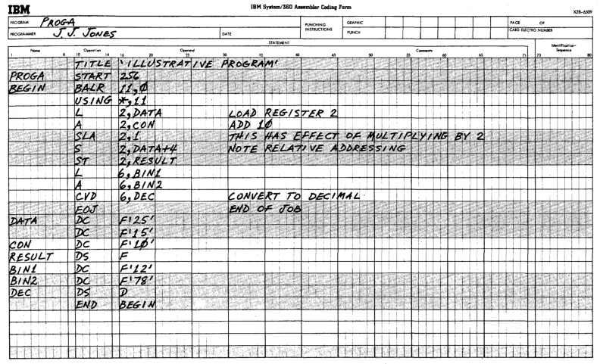
Assembly Language Coding Sheet

Slide 15
Assembly Language
Easier to remember and code, less error prone
Locations identified by name
Identifiers can be mapped to different memory addresses (this is one of the things a loader does
Problems: Still tied to machine architecture – you can’t take an assembly language program and run it on a different machine

Slide 16
Higher Level (compiled) Language
Instruction | Action
inventory = inventory - 12; | Subtract 12 from the value in the specified location
If ( inventory <= 20 ) goto low_inventory; | In the value of inventory is less than or equal to 20, jump to the address “low_inventory”
• • •
low_inventory:
Pros
Much easier and less error prone
Not tied to a particular machine (Grace Hopper’s idea!)
Cons
Early compilers generated inefficient code
Notes:
Improvements: (1) Much easier and less error prone – (2) Not tied to machine architecture (Grace Hopper’s contribution!)
Problems: May not generate efficient code. It would be years before optimizing compilers were developed.

Slide 17
Compiler Inefficiencies
Instruction | Action
inventory = inventory - 12; | LDA inventory SBA 12 STA inventory
If ( inventory <= 20 ) goto low_inventory; | LDA inventory CMPA 20, low_inventory
• • •
low_inventory:
Inefficient Code
Literal, line-by-line translation (smart, optimizing compilers weren’t developed until years later)
In this example, we generate five instructions instead of four – a 25% increase in memory requirements
Notes:
Improvements: (1) Much easier and less error prone – (2) Not tied to machine architecture (Grace Hopper’s contribution!)
Problems: May not generate efficient code. It would be years before optimizing compilers were developed.

Slide 18
Linkers and Loaders
Linkers combine machine code modules into a single program, allowing programs to be written in pieces. Linkers also allow the development of shared libraries.
Loaders load machine code program files into memory, adjust addresses, and initialize registers.

Slide 19
Building Software
High Level Language Source Code (e.g. C++)
Assembly Language Source Code
Binary Machine Code
Compiler
Assembler
optional
Executable
Machine Code
In-Memory
Code
Linker
Loader
Hardware Execution

Slide 20
Interpreters
Interpreters implement programming languages.
Like a compiler, an interpreter parses the language.
Rather than emitting assembly language, the interpreter immediately executes that language statements.
Interpreters eliminate the need for assemblers, linkers, and loaders, but the programs run much slower than compiled programs that have been converted to machine code.

Slide 21
Think About It
Our company makes the LunaVac Model 1 computer. We’ve spent years developing assemblers, linkers, loaders, compilers, and a lot of application software… all written in C++.
The hardware guys have just completed the new LunaVac Model 2 computer… but the architecture and instruction set are VERY different!
How do we get our software to run on the Model 2?

Slide 22
Step One: Write Model 2 Assembler
Devise an assembly language instruction set for the Model 2
Using C++ (or another high level language), write an assembler for the Model 2 instruction set that generates Model 2 machine code
We can now write and assemble programs on a Model 1, and emit machine code for the Model 2

Slide 23
Step 2: Write a Compiler for the Model 2
Write a compiler in C++ that compiles C++ into Model 2 assembly language
We now have a path to write C++ code, which we can then compile to emit Model 2 assembly code, which we can then assemble to generate Model 2 binary instructions This is called “cross compiling”

Slide 24
Step 3: Write (or port) Code for the Model 2
Write machine-specific code like system software using C++
Some code – things like editors, application programs, and utility programs – may not even need to be re-written. If they were originally written in C++, they can simply be “cross compiled” to move them to the new machine.

Slide 25
Course Goals and Requirements
One of the important goals of this class is to understand how system software components fit together and the problems that they solve, so that you can use them to address real problems.
This is not a programming-intensive class. Programming exercises will be very short. But if you don’t have a good grasp of programming, you will have a very hard time following the concepts, and keeping up with the assignments.

Slide 26
Shell scripting

Slide 27
Shell Scripting
A “shell” is a command-line interface to a computer system. The shell implements a high-level interpreted programming language.
On POSIX systems, the shell is directly accessible from the console or any authorized terminal device.
On MacOS, the shell is accessed through the Terminal program.
On Windows, the shell is accessed through the Command Prompt.
Shell commands can be entered directly, or loaded from a file.
The most commonly used shell is called bash (the Born Again SHell), and that’s the one I’ll use for my examples.

Slide 28
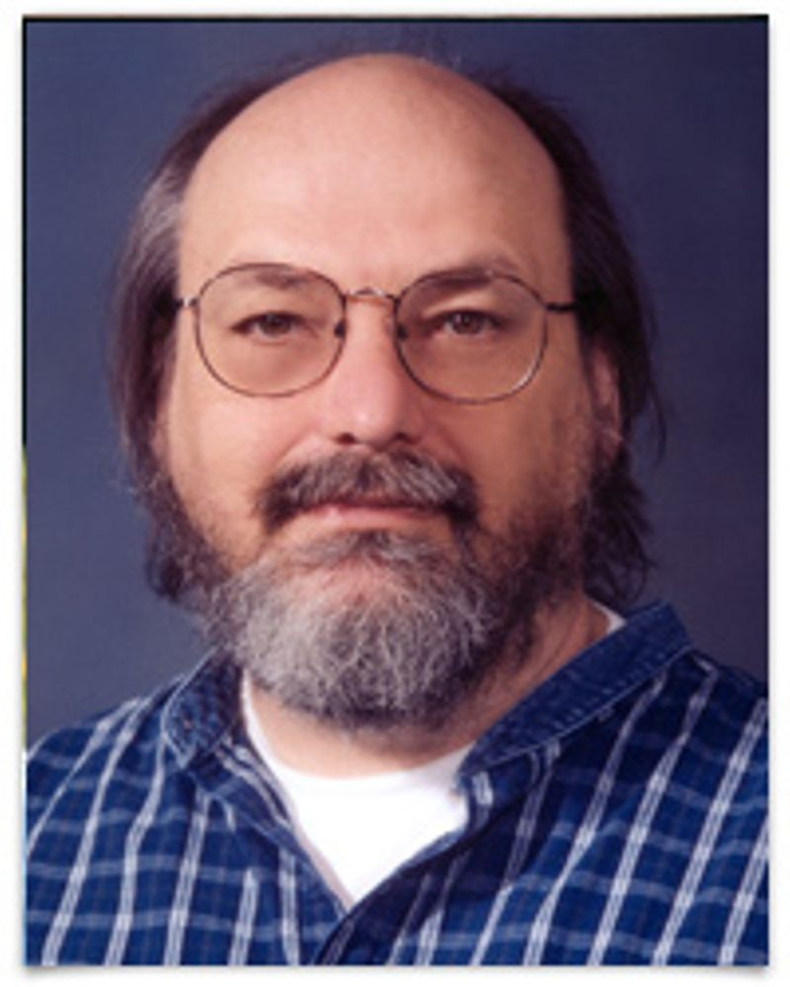
History
The first Unix shell, called sh, was developed by Ken Thompson at Bell Labs in 1971. Thompson, along with Dennis Ritchie, invented and popularized the Unix operating system. (Ritchie was also the inventor of the C programming language.)
Sh was completely rewritten by Stephen Bourne in 1979, who created the Bourne Shell. A number of spinoff and replacement shells were subsequently developed, including ksh, csh, tcsh, and bash.
Ken Thompson

Slide 29
Bash Basics
Bash has a number of built-in commands that can be executed from the command line or in a script file.
If the command line input does not correspond to a built-in shell command, the shell will look for an executable program or shell script file of that name.
The shell has a built-in variable called path. Path is an ordered list of directories (separated by “;”) that bash will search for executable programs.
Arguments can be passed to shell commands, or to programs launched from the shell, by simply appending them on the command line (with spaces as separators): command arg1 arg2 arg3

Slide 30
Bash Basics (cont)
Many shell commands accept options, indicated by a leading “-” character ls –al directory1 directory2 directory3
Multiple commands or programs can be executed from a single line, using the “;” character as a separator: command; program1 arg1 arg2; program 2
The “*” character may be used as a wildcard when matching filenames in commands: ls *.jpg
A “\” character is used to escape special characters: ls –al file\*name

Slide 31
The rc file
When an interactive shell session is launched, it automatically looks for and executes a shell startup script. In the case of bash, this file is called .bashrc
This shell startup script may be used to initialize variables, print a header message, perform cleanup activities, etc.
One of the most common things you will want to do in your startup script is set the path variable, which tells the shell where to look for programs.

Slide 32
File References
“name” refers to an unqualified program name. The shell will search for the program in the directories in the path variable: name
“/” refers to the root of the file system. Subsequent / characters are used to specify subfolders or files, e.g.: /usr/bin/name
“.” refers to the current working directory. To execute a local program rather than search the path, you would enter: ./name
“..” refers to the parent of the current working directory: ../siblingdirectory/name

Slide 33
POSIX File Permissions
Permissions are granted to three classes of user:
The file’s Owner
The file’s Group
World – which means everyone
The possible permissions for each class are read, write, and execute.
When applied to a directory, execute means that the directory can be searched or traversed.
Programs inherit the permissions of the user who launched the program, unless the program has a SUID (Set User ID) flag set, in which case it inherits the permissions of the owner of the executable file.

Slide 34
POSIX File Permissions (cont)
Permissions are displayed by commands such as ls as a nine character string, showing read/write/execute permissions for owner, group, and world. A “-” character indicates non-permission: rwxrw-r-- Owner: read, write execute Group: read, write World: read
Permissions are also represented as a three digit octal string; each bit represents one of the permissions: 0764

Slide 35
Useful Shell Commands
pwd – print the current working directory
cd – change the current working directory: cd ../../documents
ls – list directory contents. By default, the command will list the contents of the current working directory. Optionally, the command accepts a directory name: ls ../documents
ls accepts many options, prefaced by a “-” character. Useful options include: -a – list all files (by default, filenames starting with a “.” are not listed -l – list files in long format (show ownership, permissions, and date) -r – list files recursively

Slide 36
Useful Shell Commands (cont)
chmod – change of permissions on files chmod 750 file1 file2 file3
cat – concatenate the specified files, and send the result to STDOUT (the standard output) cat file1 file2 file3
grep – search the designated file and output lines matching the specified regular expression grep expression file
history – list the history of commands executed in the current shell session

Slide 37
Useful Shell Commands (cont)
!! – repeat the previous command
!(chars) – repeat the most recent command starting with the designated characters: !ls
!(number) – repeat the specified command number. Bash keeps a numerically indexed list of all commands executed in the current session, starting with 1. !173
^(pattern)^(replacement) – repeat the previous command, replacing instances of pattern with the replacement string: ^Tuesday^Wednesday

Slide 38
Standard File Streams
When POSIX systems launch a program, the system automatically opens three file streams:
STDIN – standard input
STDOUT – standard output
STDERR – standard error reporting stream
Bash allows you to assign these streams when programs are launched, using the “<“ and “>” characters.
Execute a program and assign the contents of a file to STDIN program <file
Execute a program and direct STDOUT to a file (replacing the contents) program >file

Slide 39
Standard File Streams (cont)
Execute a program and direct STDOUT to a file (appending to the contents): program >> file
Execute a program and direct STDERR to a file: program 2> file
File direction can be combined with arguments: program arg1 arg2 <myinput >myoutput

Slide 40
Pipelines (aka Pipes)
Multiple programs can be executed from a single line. The STDOUT stream of each program can be attached to the STDIN stream on the next using the “|” character: program1 argument | program2 | program3

Slide 41
Variables
Bash allows the setting and retrieval of variables.
To set a variable, simply append an equal sign after its name (no spaces): today=Wednesday
To set a value including spaces, quote the string: today=“Wednesday, January 8, 2020”
To reference a variable, prepend a dollar sign to its name: echo $today
To append to a variable, reference it and follow the reference with the additional contents: path=$path;/usr/bin/local

Slide 42
Conditionals
By convention, programs return a 0 for success and a 1 for failure.
command1 && command2 – execute command2 if – and only if – command 1 succeeds
command1 || command2 – execute command2 if – and only if – command 1 fails
[[ condition ]] – The bracket characters are used to evaluate the condition and return success or failure: [[ $today==Wednesday ]]

Slide 43
Conditional Expressions
Expression | True if:
[[ string1 == string2 ]] | string1 is equal to string2
[[ string1 != string2 ]] | string1 is not equal to string2
[[ num1 –eq num2 ]] -ne, -lt, -le, -gt, -ge | num1 is equal to num2 Not equal, less than, less than or equal, greater than, greater than or equal
[[ -e file ]] | File exists
[[ -r file ]] | File is readable
[[ -w file ]] | File is writeable
[[ -x file ]] | File is executable
[[ file1 -nt file2 ]] | File1 is more recent than file2

Slide 44
Conditional Blocks: if
Block statements can be used in scripts, but not on the command line.
if condition then - Execute statements if the condition is true statements else statements fi if [[ $today == “Wednesday” ]]; then echo “It\’s Wednesday” else echo “It\’s not Wednesday” fi

Slide 45
Loop Blocks: for
Block statements can be used in scripts, but not on the command line.
for variable in values do statements done – iterates through values for day in Mon Tue Wed Thu Fri do echo $day done
Values may be specified as a range: for value in {1..100} do echo $value done

Slide 46
Loop Blocks: while
Block statements can be used in scripts, but not on the command line.
while [ condition ] do statements done – iterates while condition is true while [ $i –lt 100] do i = $[$i+1] echo $i done

Slide 47
make

Slide 48
What is Make?
Make is an application to organize and automate the process of compiling programs.
Make builds programs based on instructions in a file, called a makefile.
A makefile contains:
A list of dependencies (e.g. a hierarchical list files that go into building a program)
Instructions for building the program and its components

Slide 49
History
Make was created by Stuart Feldman, at Bell Labs, in 1976
Feldman received the 2003 ACM Software System Award for the authoring of this widespread tool
Ken Thompson and Dennis Ritchie were not the only people working on Unix!
Prior to make, most programmers created shell scripts to build complex programs
Make is now part of the POSIX standard, so makefiles are reasonably portable

Slide 50
Dependencies: Example
A program – prog.exe – is dependent on several object files prog.exe depends on module1.o, module2.o, and module3.o
Each object file depends on a source file and an include file. module1.o depends on module1.c and module1.h module2.o depends on module2.c and module2.h module3.o depends on module3.c and module3.h

Slide 51
Instructions: Example
There are instructions (command lines) for:
Building each of the object files by compiling the source and include files
Building the program file by linking the object files

Slide 52
Using Make
When make is run it checks the modification dates of all dependencies, and executes the necessary instructions to build the program
For example, if only module2.c has changed, then: module2.o will be rebuilt by compiling module2.c the program will be rebuilt by linking module1.o. module2.o, and module3.o
Note that module1.o and module3.o will not be rebuilt, because the underlying source files on which they depend have not changed

Slide 53
Makefile: Example of a Make Rule
target: dependencies command 1 command 2 command 3 hellomake: hellomake.c hellofunc.c gcc -o hellomake hellomake.c hellofunc.c -I.
The first line lists the dependencies for the program hellomake
The second line lists the command line for building hellomake (the target)
Command lines must begin with a tab character (not spaces)
You can have multiple rules – separated by blank lines - in a makefile

Slide 54
Invoking Make
To build the program, type the make command on the command line: make
Make will look for a file called “makefile” in the current working directory
The target on the first line will be built
That first rule may include other targets as dependencies, thus triggering those rules
You can include several independent programs in a makefile, in which case you would need to specify which program to build: make hellomake

Slide 55
Make Macros
Make supports macros, which are similar to variables CC=gcc CFLAGS=-I. hellomake: hellomake.o hellofunc.o $(CC) $(CFLAGS) -o hellomake hellomake.o hellofunc.o
Note that we don’t list hellomake.c as a dependency for hellomake.o.
We also don’t provide a command line for building hellomake.o.
These rules are built in to make. You may not be comfortable depending on built-in rules; feel from to include explicit rules.

Slide 56
Predefined Macros
Macro | Definition | Default | Macro | Definition | Default
AS | Assembler | as | ASFLAGS | Flags for assembler | (none)
CC | C compiler | cc | CFLAGS | Flags for C compiler | (none)
CXX | C++ Compiler | c++ | CXXFLAGS | Flags for C++ compiler | (none)
CPP | C pre-processor | $(CC) -E | CPPFLAGS | Flags for C pre-processor | (none)
FC | Fortran 77 compiler | f77 | FFFLAGS | Flags for Fortran compiler | (none)
GET | Extract a file from SCCS | get | GFLAGS | Flags for SCCS | (none)
LINT | Run Lint on source code | lint | LINTFLAGS | Flags for lint | (none)
PC | Pascal compiler | pc | PFLAGS | Flags for Pascal compiler | (none)
RM | Remove a file | rm -f | LDFLAGS | Flags for C/C++ loader | (none)

Slide 57
Generic Rules
If you don’t want to rely on built-in make rules, you can create your own generic rules: CC=gcc CFLAGS=-I. DEPS = hellomake.h hellomake: hellomake.o hellofunc.o $(CC) -o hellomake hellomake.o hellofunc.o %.o: %.c $(DEPS) $(CC) -c -o $@ $< $(CFLAGS)
$@ - automatic variable that contains the target name
$< - automatic variable that contains the dependencies name

Slide 58
Rules You Should Include
These are conventions that experienced users expect in every makefile
all: useful if your makefile includes several top-level program all: program1 program2 program3
clean: delete all intermediate files (such as .o files, libraries, etc) and then make the top level target.
This is useful when something just isn’t working right and you suspect you may have a corrupted object file, incorrect modification dates, etc.
install: install the targets in appropriate directories; set permissions; etc

Slide 59
Make for Everything
Make is not limited to building programs!
For example, you could use make to generate a report. The commands might include doing several database queries, and concatenating the output of each into a report file.

Slide 60
For Next Week
Recommended: Read chapter 1 of the text
Log in to Canvas and:
Submit a copy of your transcript, with the prerequisites highlighted
Download the Academic Integrity Pledge, sign it, and submit it
Note that the Transcript and the Academic Integrity Pledge are required by the department; if you don’t submit them, you will be dropped from the class.

